Slide 1
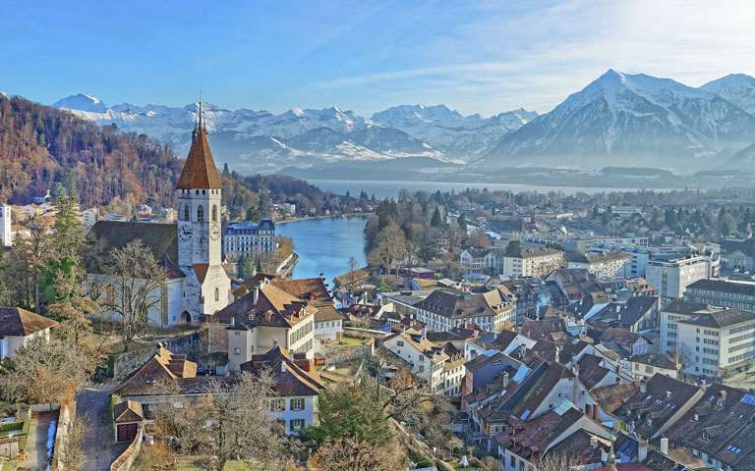
Rhineland
Pim Huisman – Concept / Environment Art
Scott Vetketel – Environment Art
Jens Walgien – Character Art
Jorrit Kornelis – Producer
Daniël Stremmelaar – Programmer / Game Design

Slide 2
Inhoud
Changes
Reflection
Art Progression
Plans
Prototype

Slide 3
Changes
Resources
Upgrade system
Supply chain

Slide 4
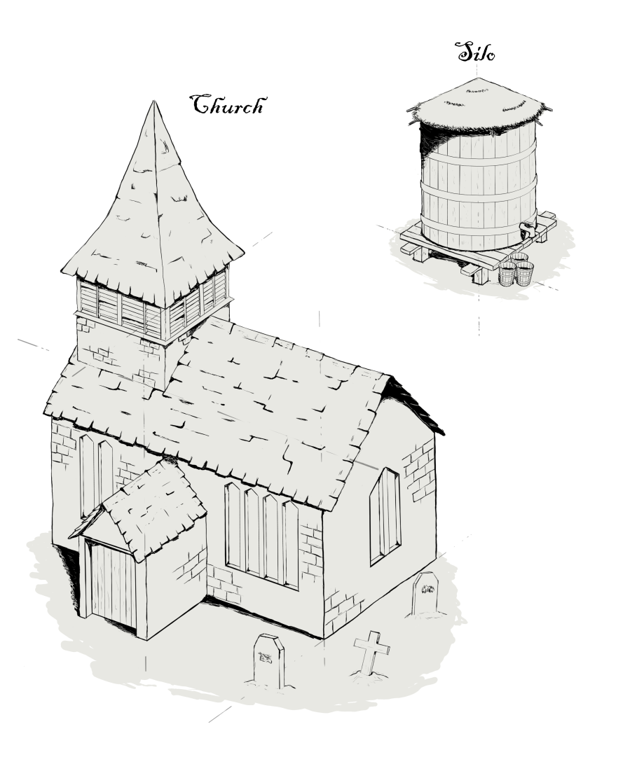
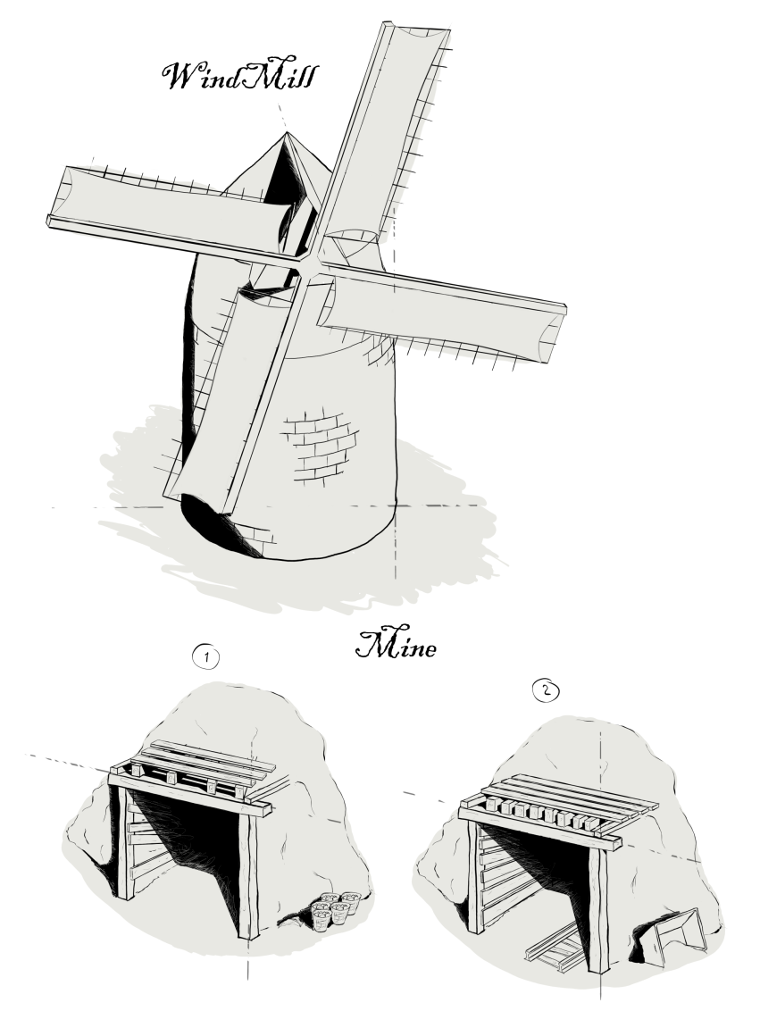
Art Progression

Slide 5
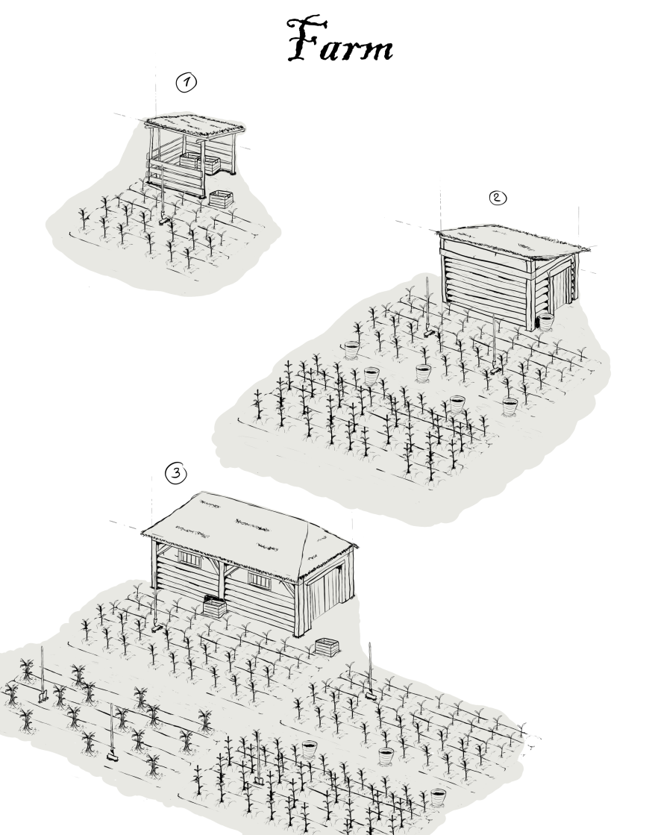
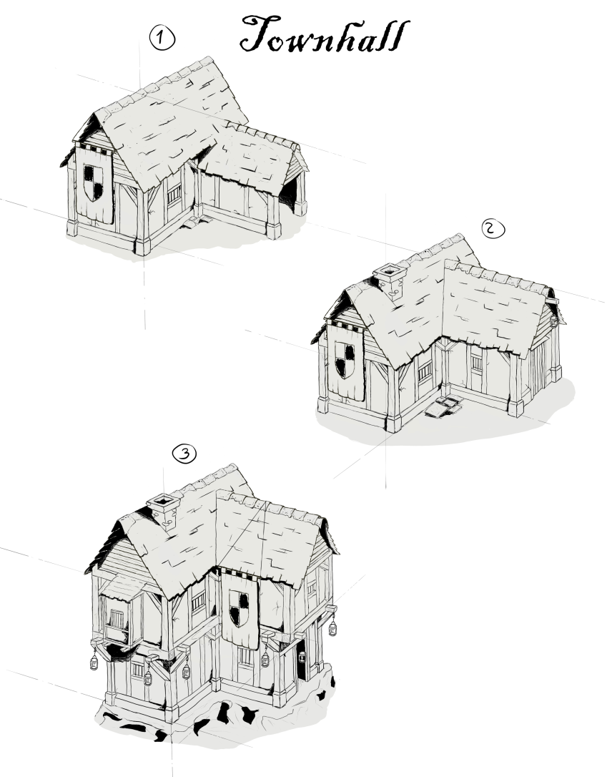
Art Progression

Slide 6
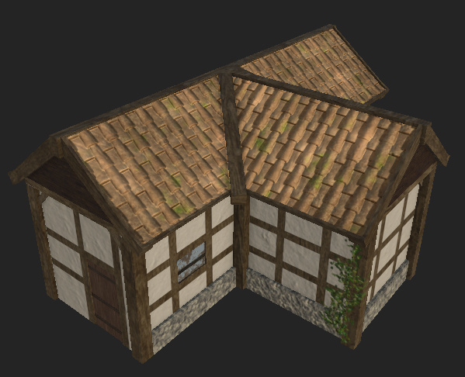
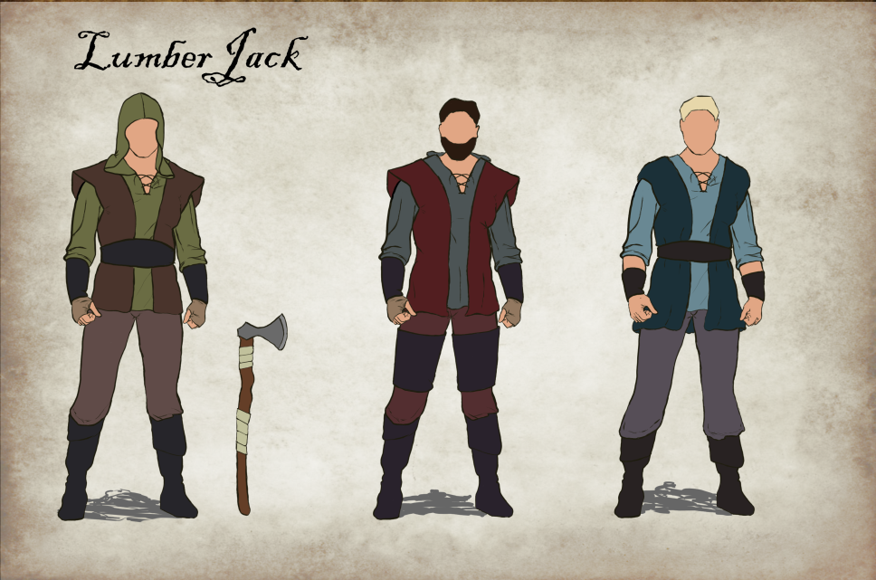
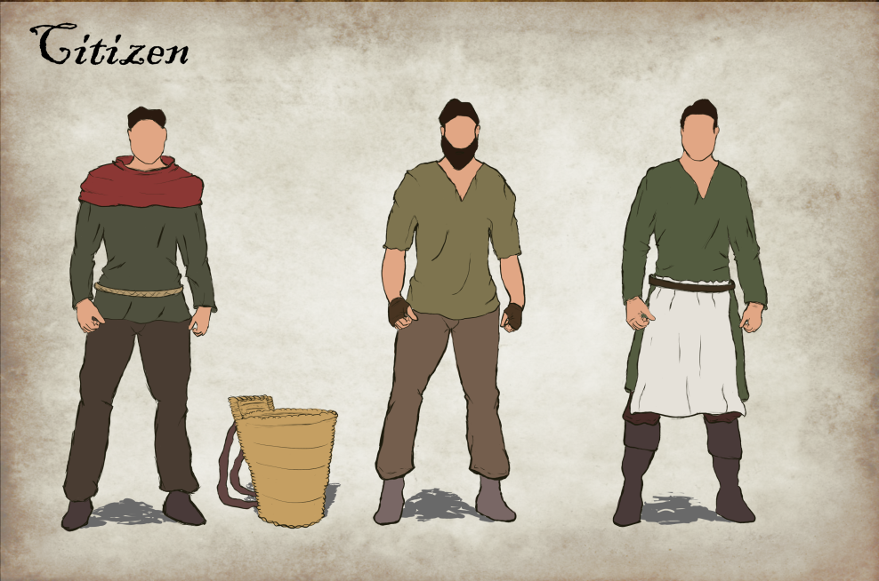
Art Progression

Slide 7
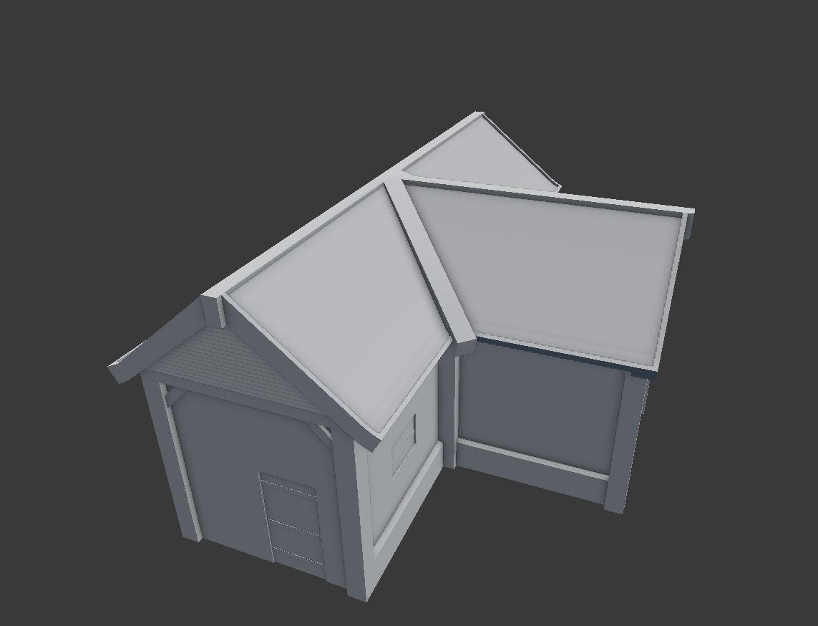
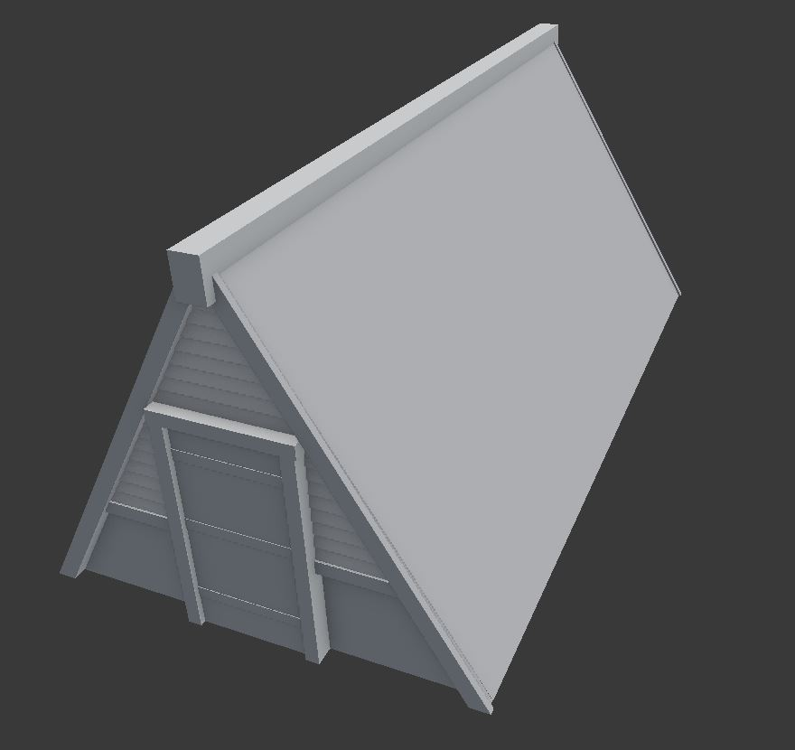
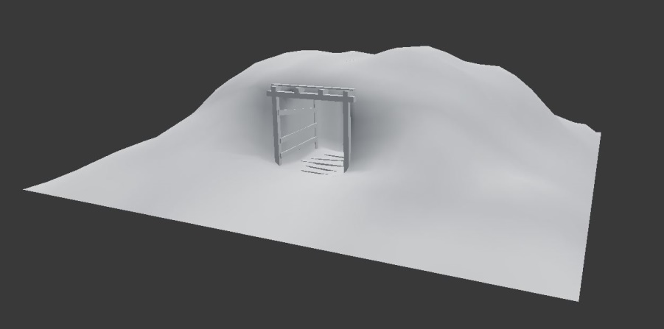
Art Progression

Slide 8
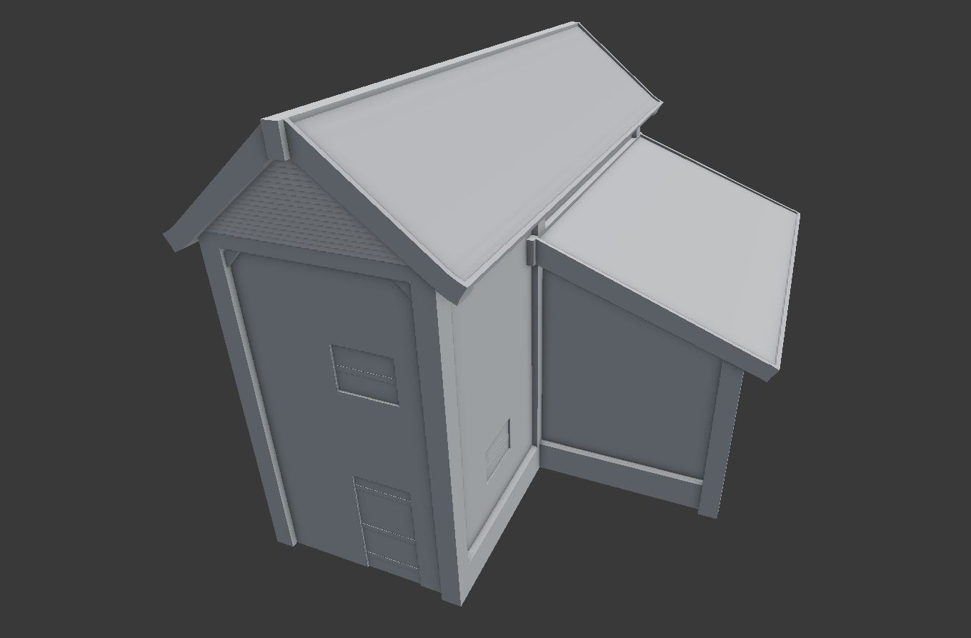
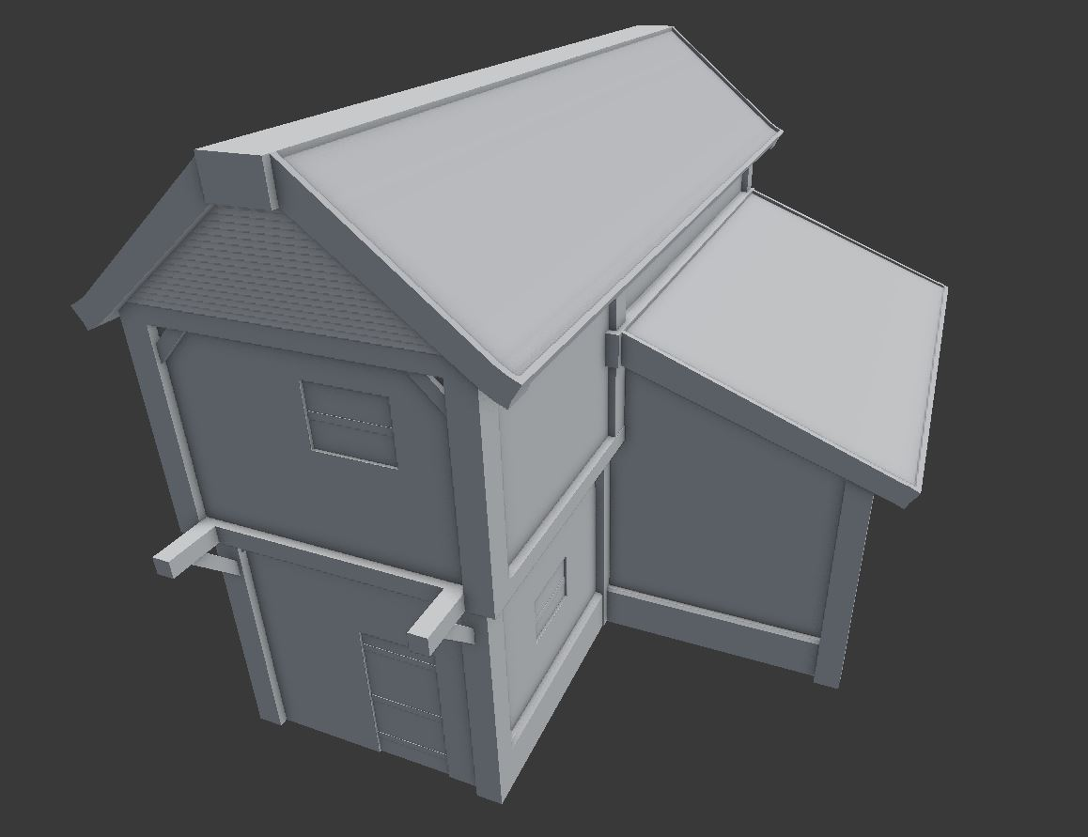
Art Progression

Slide 9
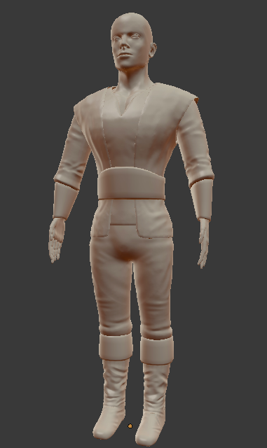
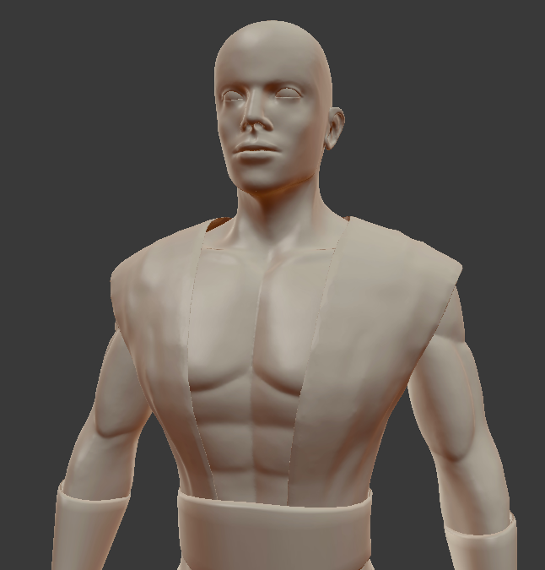
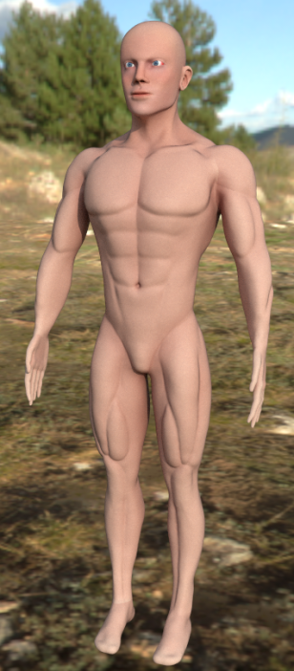
Art Progression

Slide 10
Plans
Happiness
Starvation
Random map
Spawn selection

Slide 11
Prototype

